Slide 1
Venue Vision: Striving towards a sustainable future for tennis venues in Surrey

Slide 2
External influences on decision making in your venue…

Slide 3
The reality of external influences on decisions in your venue…

Slide 4
Case Study: King’s College London (KCL) Tennis Club

Slide 5
Active participation in national wide initiatives
Using soft power when striking deals
Taking action into our own hands

Slide 6
1.Active participation in national wide initiatives

Slide 7
2. Using soft power when striking deals

Slide 8
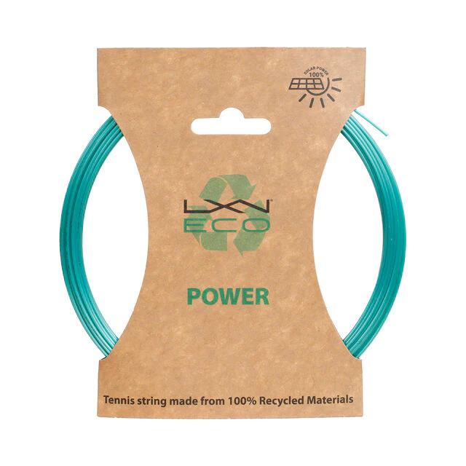
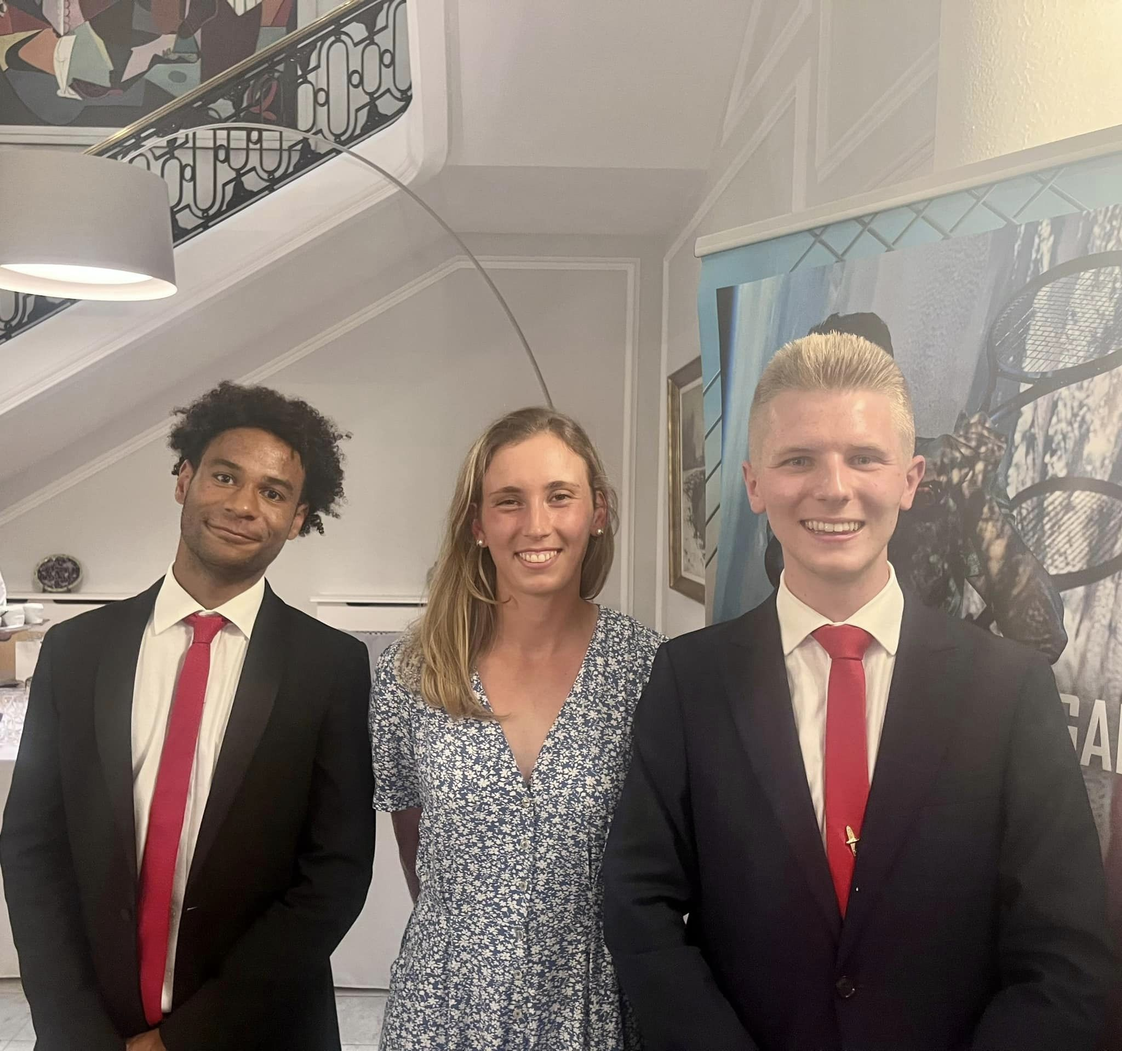
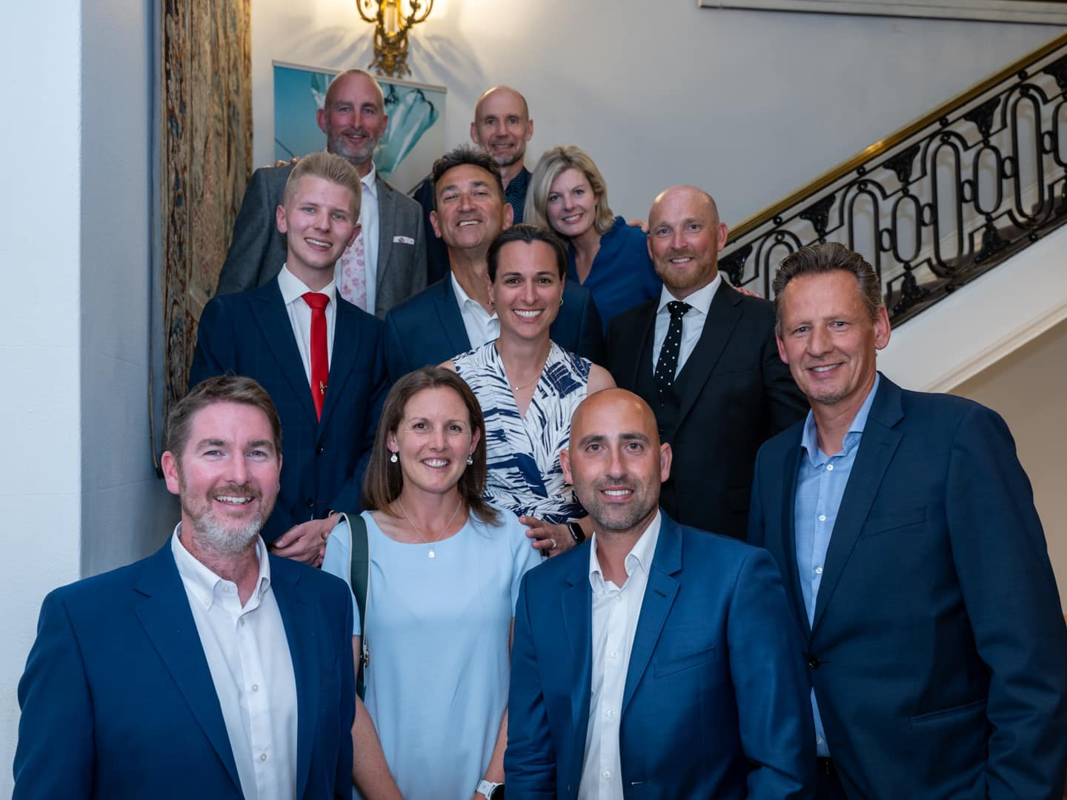
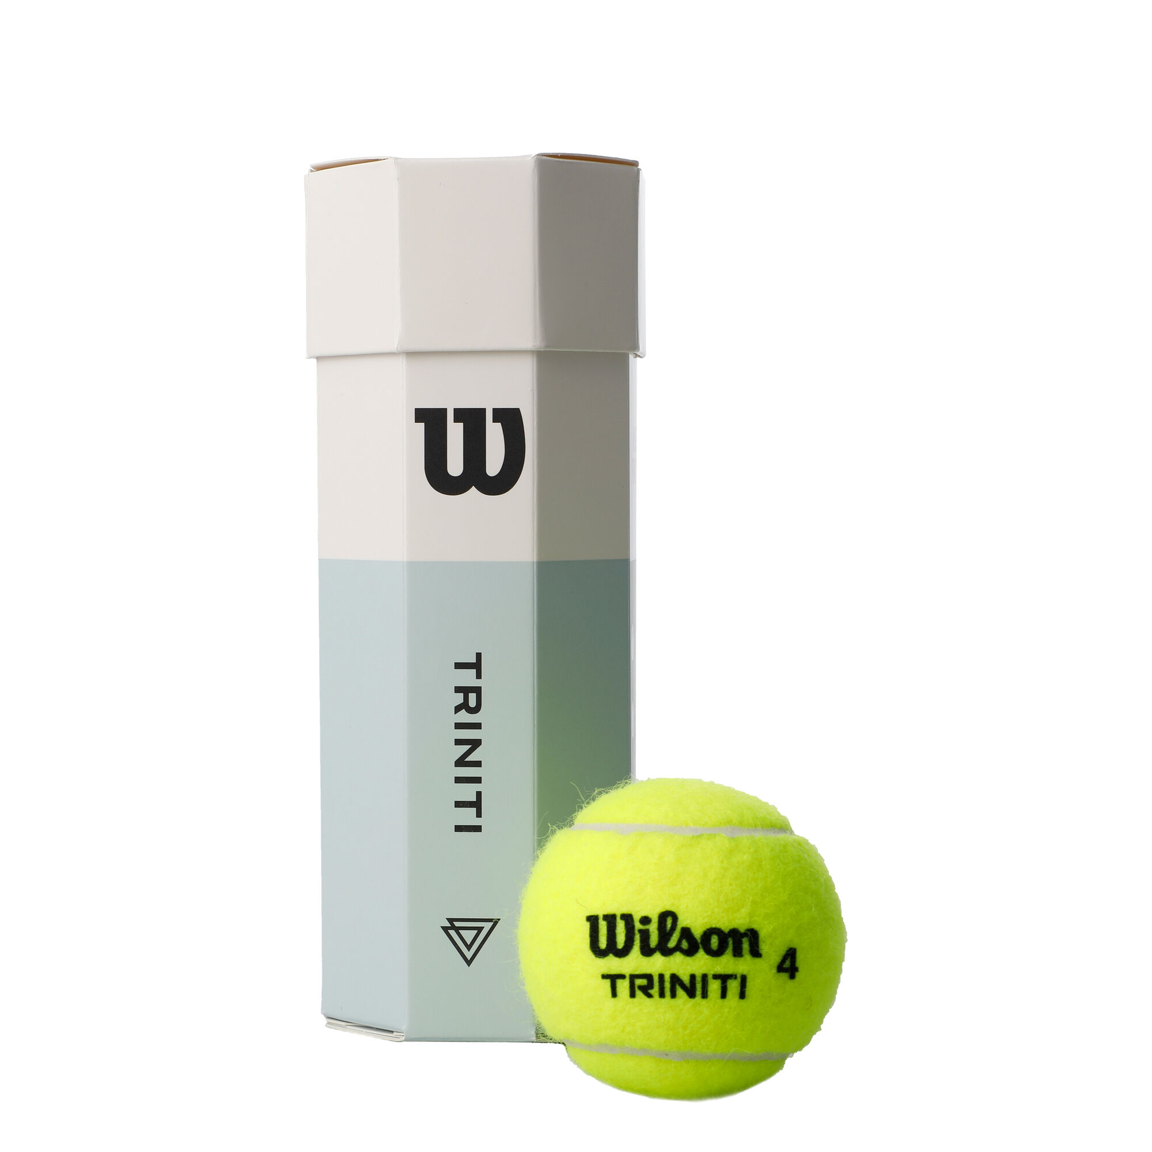
3.Taking action into our own hands

